Slide 1
INTRODUCTION TO GRAPHIC DESIGN MOVEMENT, BALANCE, UNITY, CONTRAST, EMPHASIS, LINE, AND COLOR

Slide 2
GRAPHIC DESIGN
Graphic design is the process of visual communication and problem-solving using one or more of typography, photography and illustration. The field is considered a subset of visual communication and communication design

Slide 3
USE OF GRAPHIC DESIGN
Common uses of graphic design include corporate design (logos and branding), editorial design (magazines, newspapers and books), way finding or environmental design, advertising, web design, communication design, product packaging and signage.

Slide 4
Graphic design elements
Graphic design elements are the building blocks of graphics.
Line
Color
Shape
Texture

Slide 5

LINES
Lines can be straight or curved.
How are lines used in the composition on this slide?

Slide 6
COLOR DEFINITIONS
Hue is another word for color.
Chroma is the intensity or purity of color.
Tint is a color mixed with white.
Tone is a color mixed with gray.
Shade is a color mixed with black.

Slide 7
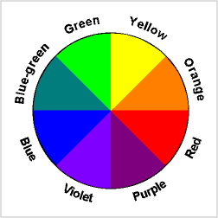
COLOR AND CONTRAST
Using color can enhance or detract from a composition.
Color wheels help determine which colors are in greatest contrast.

Slide 8
COLOR IN DESIGN
Use color to label or show hierarchy.
Use color to represent or imitate reality.
Use color to unify, separate, or emphasize.
Use color to decorate.
Use color consistently

Slide 9
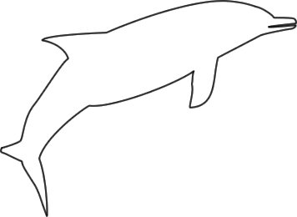
SHAPES
Shapes are enclosed objects that can be created by line or created by color and value changes that define their edges.

Slide 10
TEXTURE
Texture is the surface look of an object created by varying dark and light areas.
Roughness
Smoothness
Depth

Slide 11
GRAPHIC DESIGN PRINCIPLES
Graphic design principles are ways in which elements are used together.
Movement
Balance
Emphasis
Unity

Slide 12
MOVEMENT
Movement is the use of lines, color, and repetition to create the illusion of motion.
Curved forms or lines
Repetition of geometric forms
Fuzzy lines or outlines

Slide 13

LINES
Lines can indicate motion or direction.
How are lines used in the composition on this slide?

Slide 14
BALANCE
Balance is the act of comparing or estimating two things, one against the other, and the contrast between:
Empty space (white space) and filled space
Text and images
Color and no colors and different colors
Textures against flat colors

Slide 15
BALANCE IN COMPOSITION
There are three different types of balance when using color, shape, and position:
Symmetry
Asymmetry
Radial symmetry

Slide 16
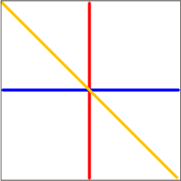
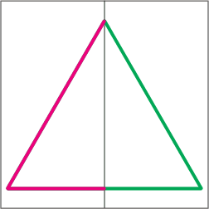
SYMMETRICAL BALANCE

Slide 17
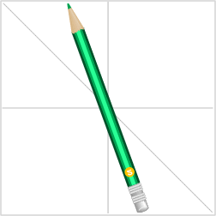
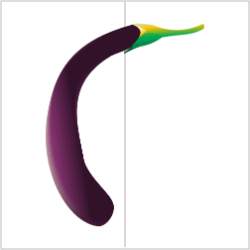
ASSYMMETRIC BALANCE

Slide 18

UNITY
Unity: The correct balance of composition or color that produces a harmonious effect.

Slide 19

EMPHASIS
Emphasis: To express with particular stress or force.

Slide 20

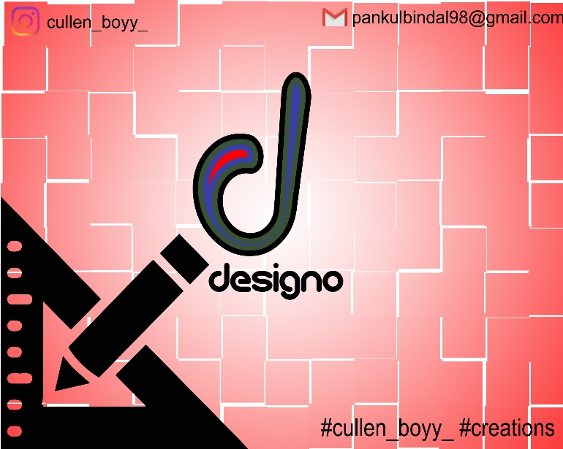

Some examples of Graphic Designs

Slide 21
SUMMARY
The basis of good graphic design is use of design elements and their thoughtful application in the form of design principles.
Clearly identify what you are trying to accomplish — use design to convey your message.
Brainstorm alternatives.

Slide 22
THANK YOU!!!

